Slide 1




SFFA
Random Forests and Applications in Financial Planning

Slide 2

SFFA
Brief Agenda
03.
04.
05.
06.
What is A Random Forest?
Ensemble Learning
Decision Trees
How it works ?
07.
08.
09.10.
Terms and Hyperparameter
Dataset Preparation
Advantages & Disadvantages
Random Forest Financial Application

Slide 3

SFFA
What is A Random Forest
Basic Concept
A random forest algorithm is a supervised machine learning algorithm consisting of decision trees.
It operates by constructing multiple Decision Trees during the training phase.
The decision of the majority of the trees is chosen by the random forest as the final decision

Slide 4
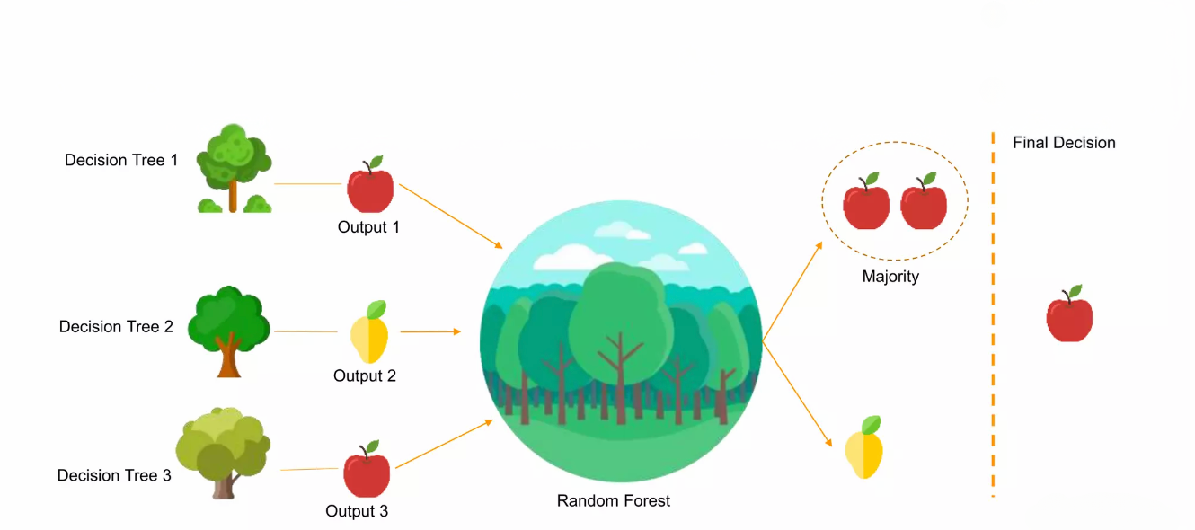
SFFA
What is A Random Forest
Example

Slide 5
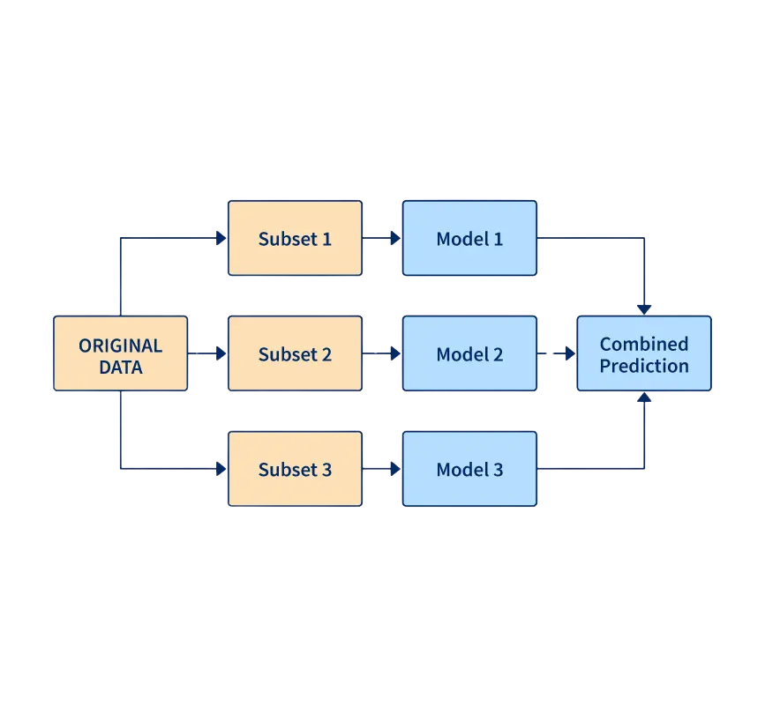
SFFA
Ensemble Learning
Ensemble learning creates a stronger model by aggregating the predictions of multiple weak models. Random Forest is an example of ensemble learning where each model is a decision tree. The idea behind it is - the wisdom of the crowd. The majority vote aggregation can have better accuracy than the individual models.

Slide 6
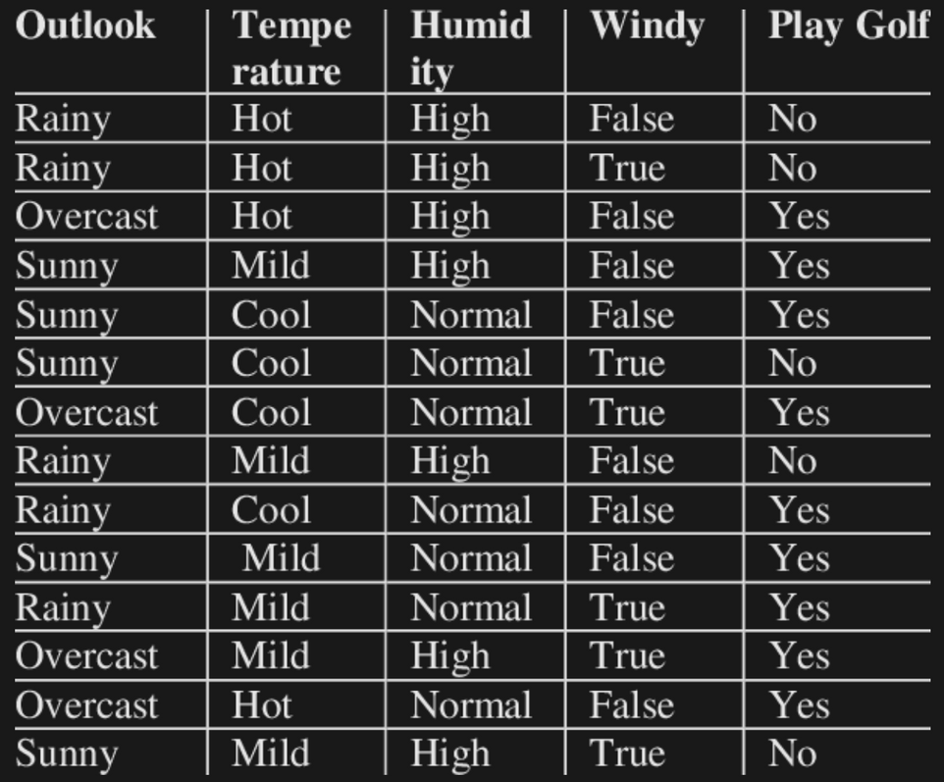
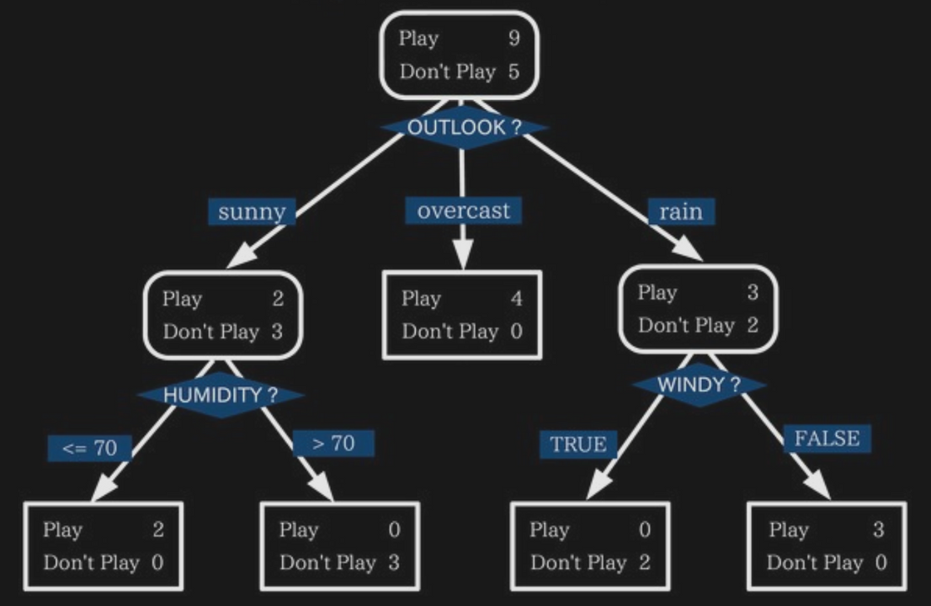
SFFA
Decision Trees Example
Dataset
Desicion Tree

Slide 7
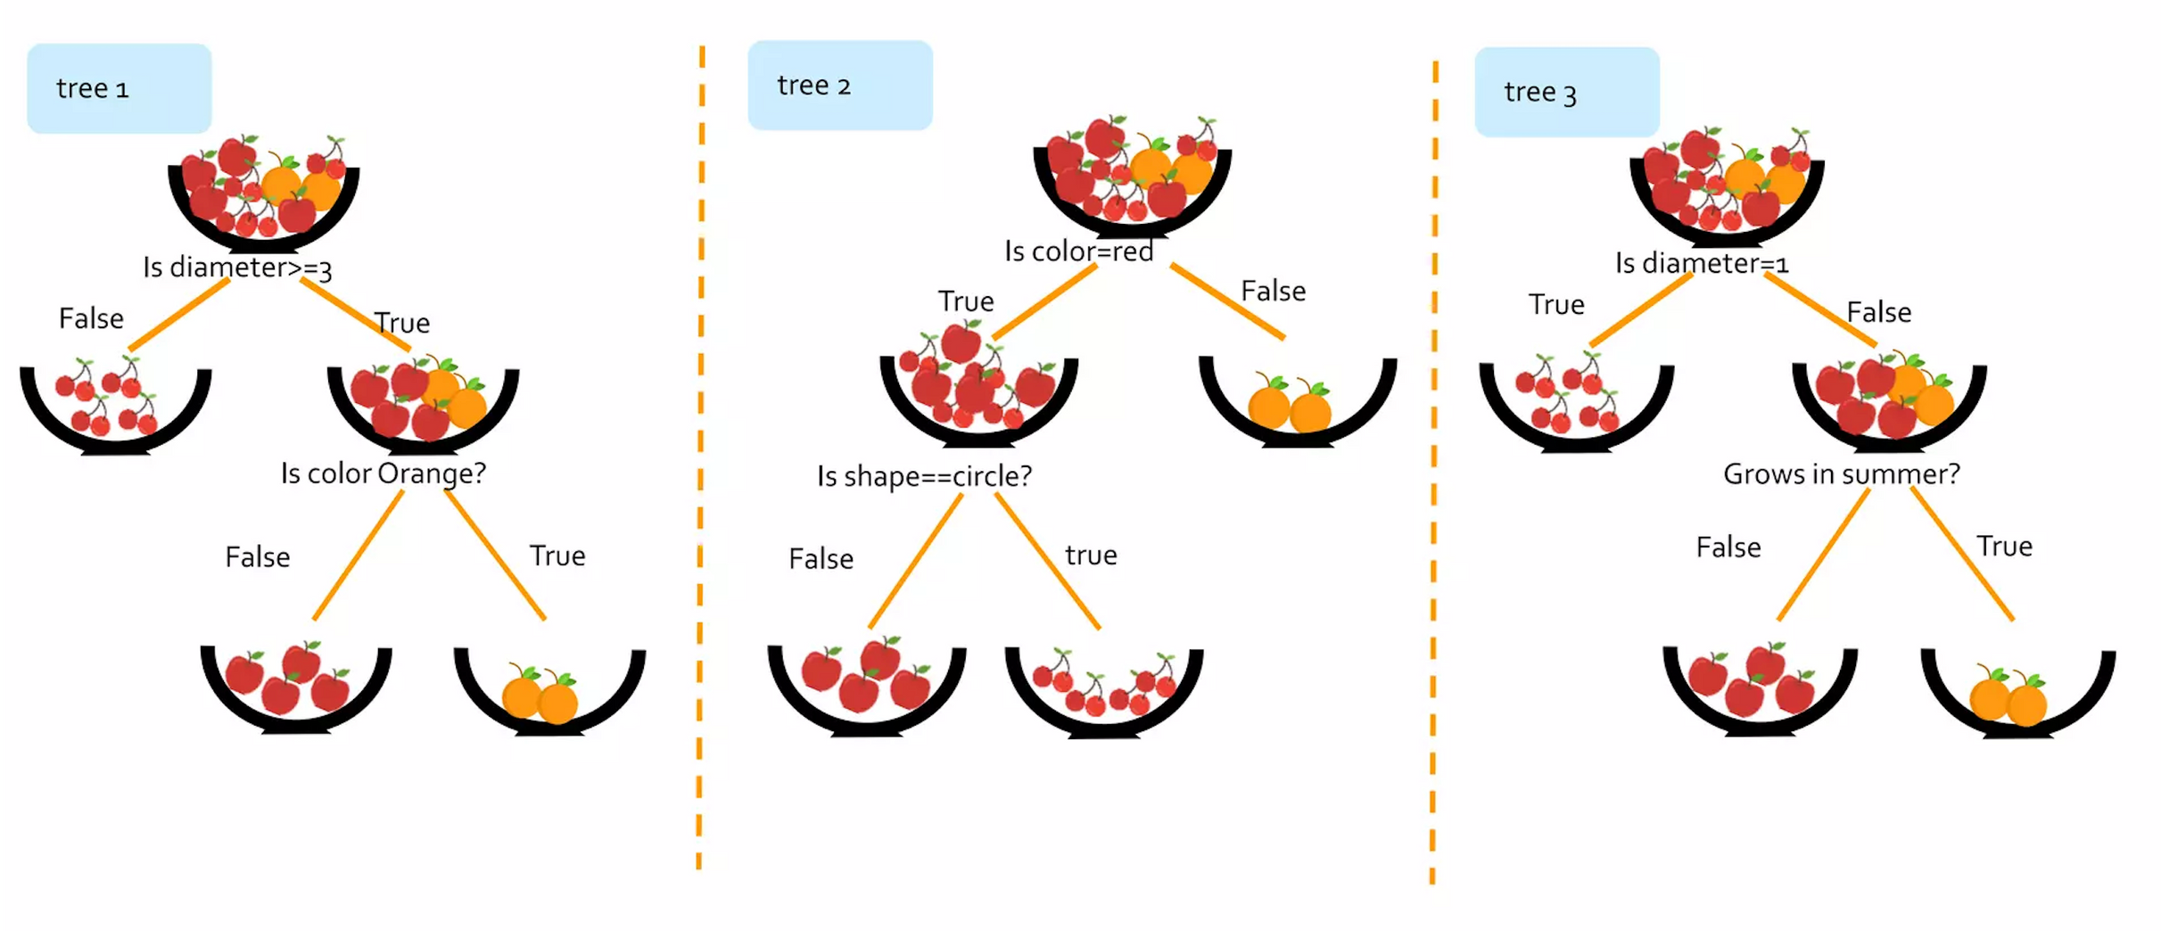
How does a Random Forests Works?
SFFA

Slide 8

How does a Random Forests Works?
SFFA

Slide 9
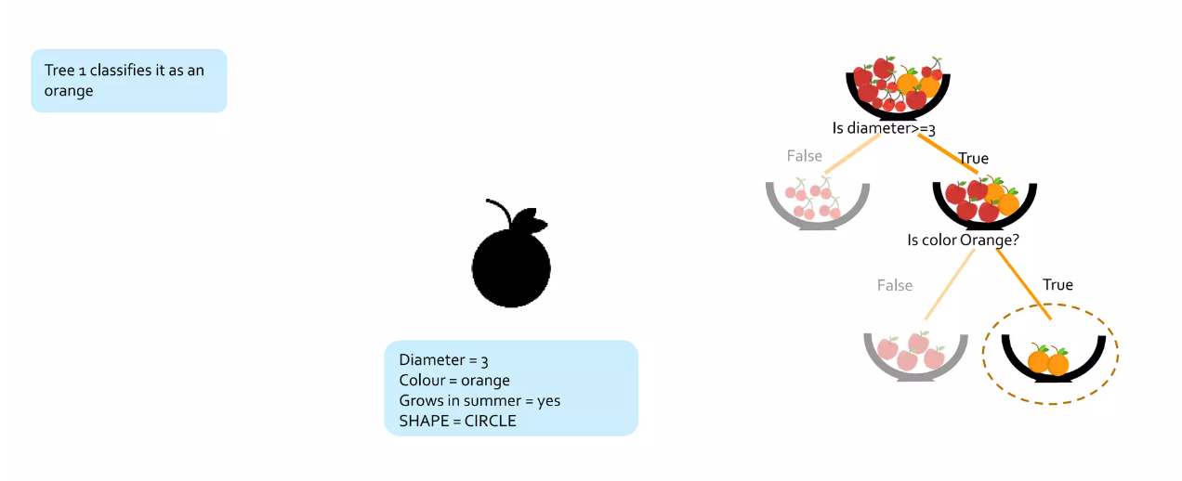
How does a Random Forests Works?
SFFA

Slide 10
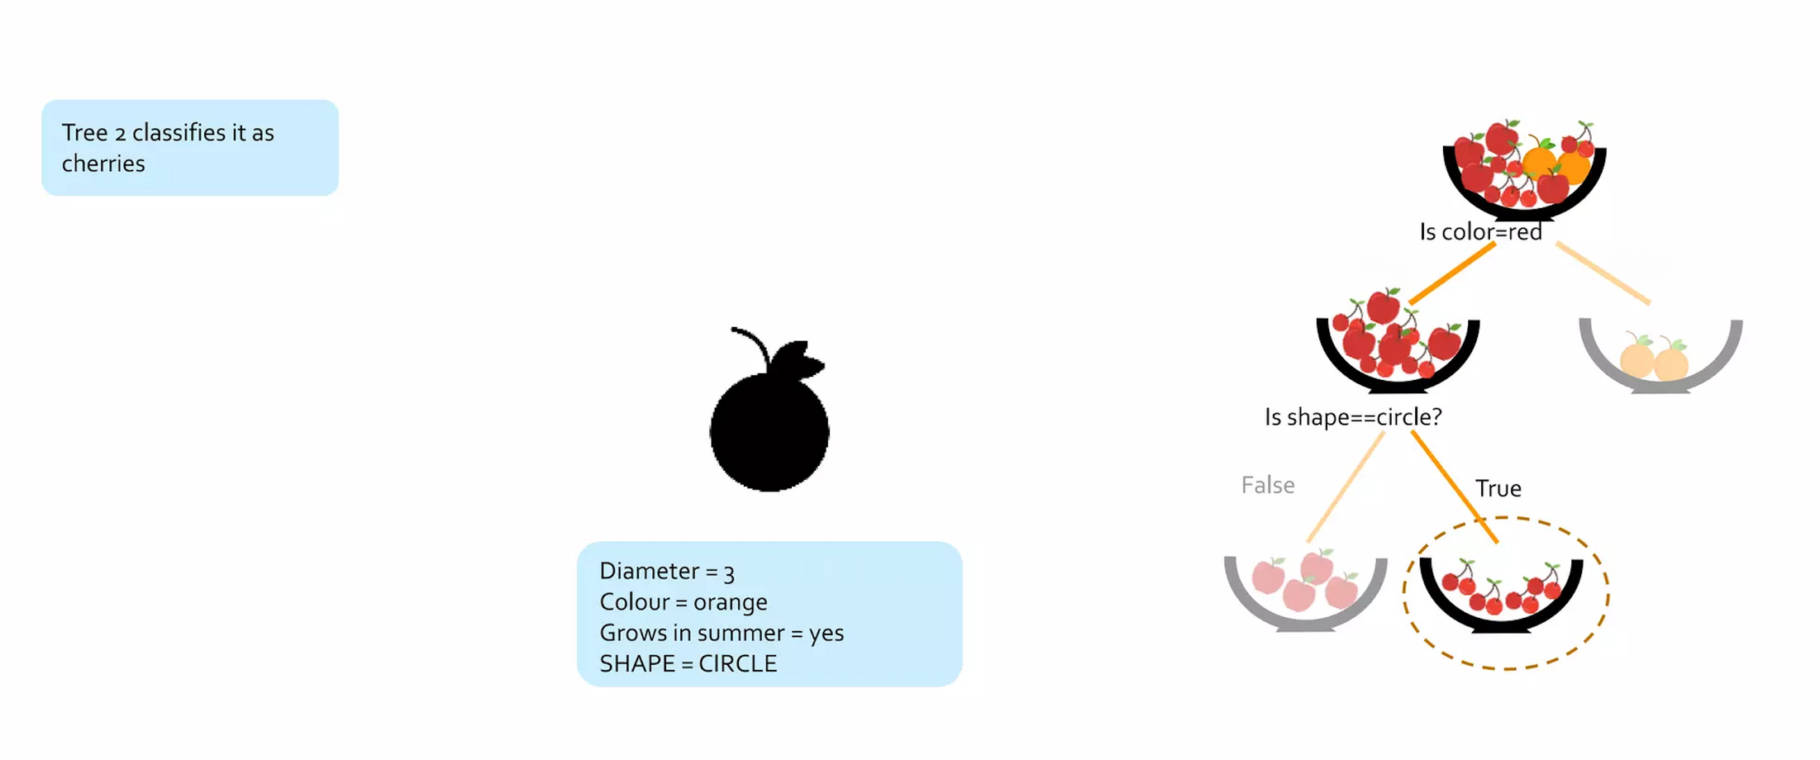
How does a Random Forests Works?
SFFA
False
True

Slide 11
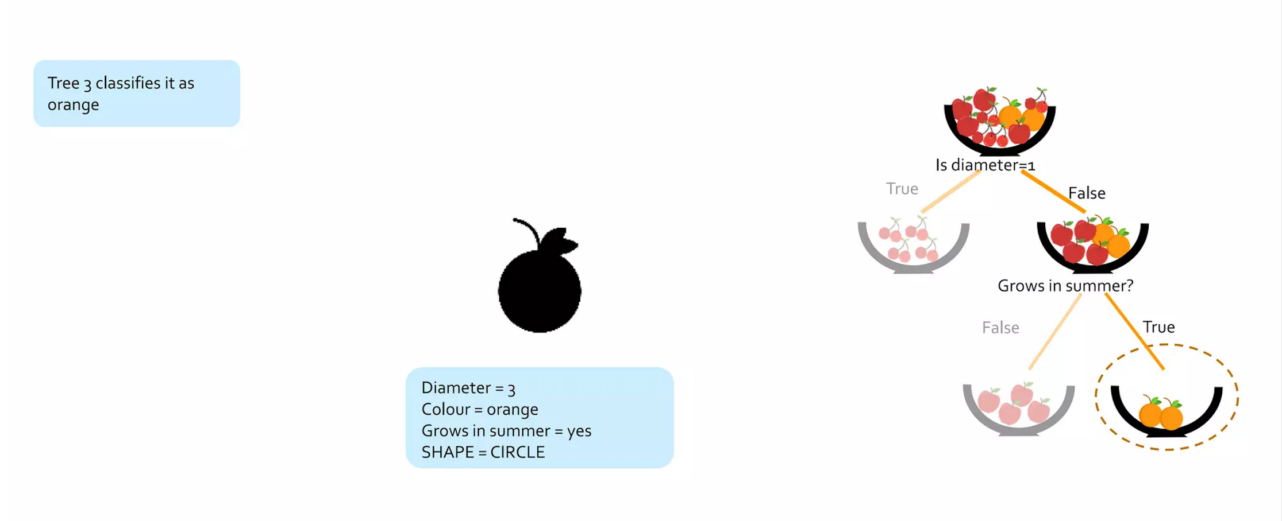
How does a Random Forests Works?
SFFA

Slide 12
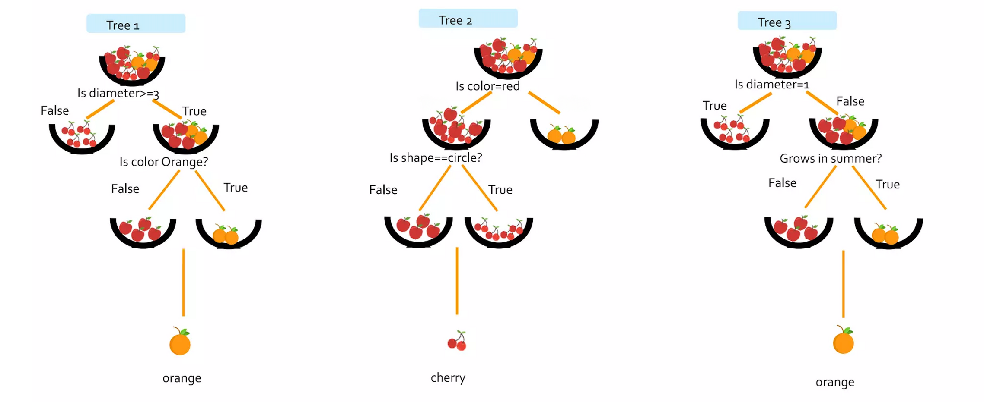
How does a Random Forests Works?
SFFA
False
True

Slide 13
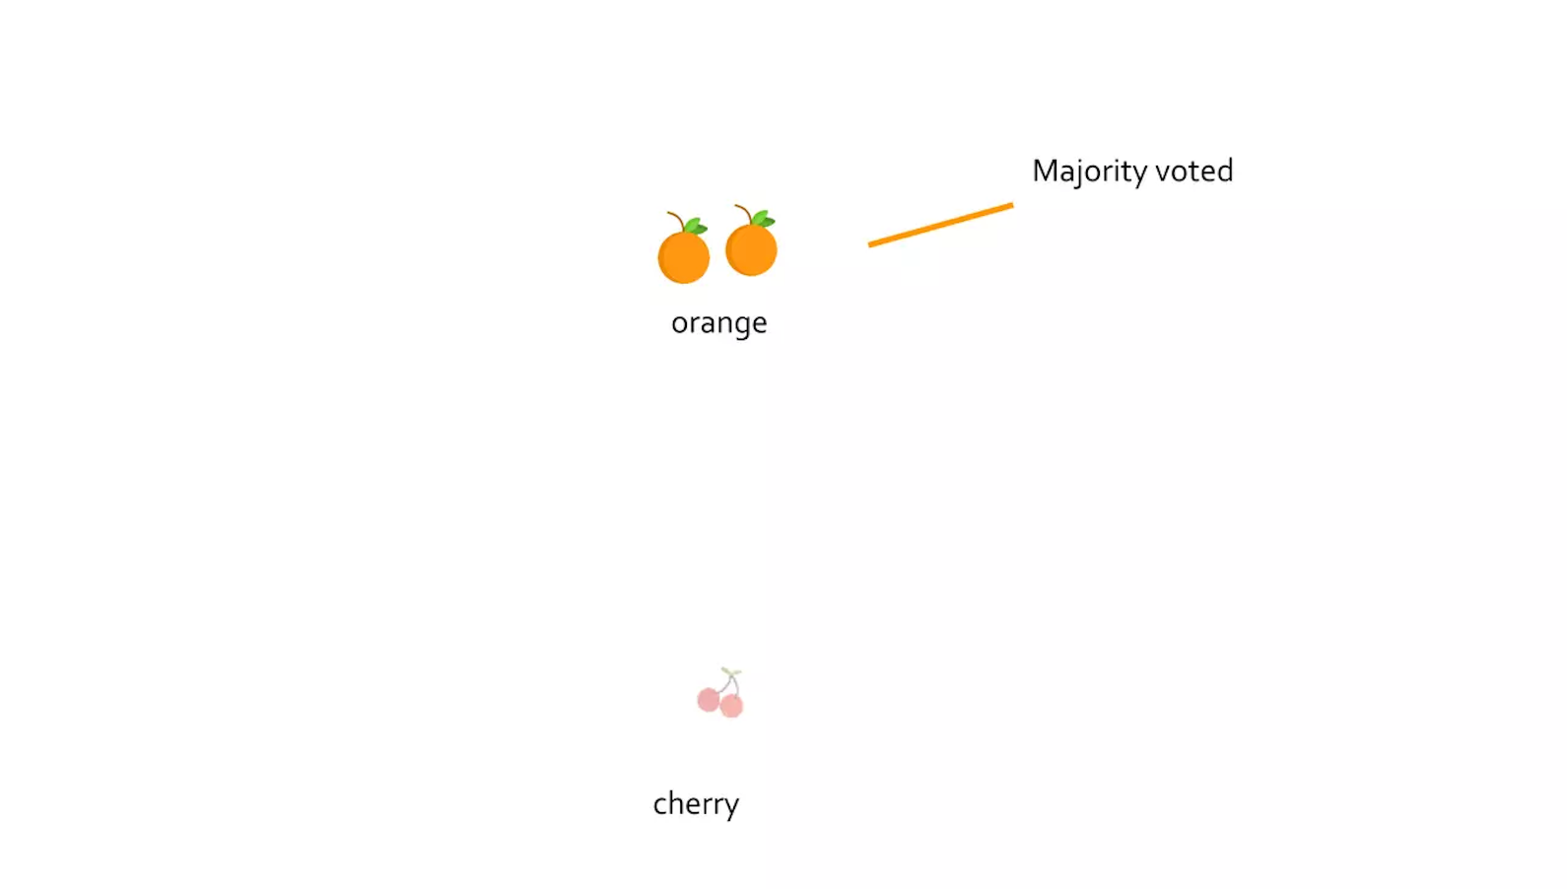
How does a Random Forests Works?
SFFA

Slide 14
SFFA
Important Terms
Entropy: Is a measure of randomness or unpredictability in the data set.
Information Gain: is a measure of the decrease in the entropy after the data set is split.
Leaf Node: is a node that carries the classification or the decision.
Decision Node: is a node that has two or more branches.
Root Node: is the topmost decision node.

Slide 15
SFFA
Important Hyperparameters
Hyperparameters are used in random forests to either enhance the performance and predictive power of models or to make the model faster.
Predictive power hyperparameters
Speed hyperparameters
n_estimators: Number of trees.
mini_sample_leaf: Minimum number of leaves required to split an internal node.
n_jobs: Number processors allowed to use.
random_state: Controls randomness of the sample.

Slide 16
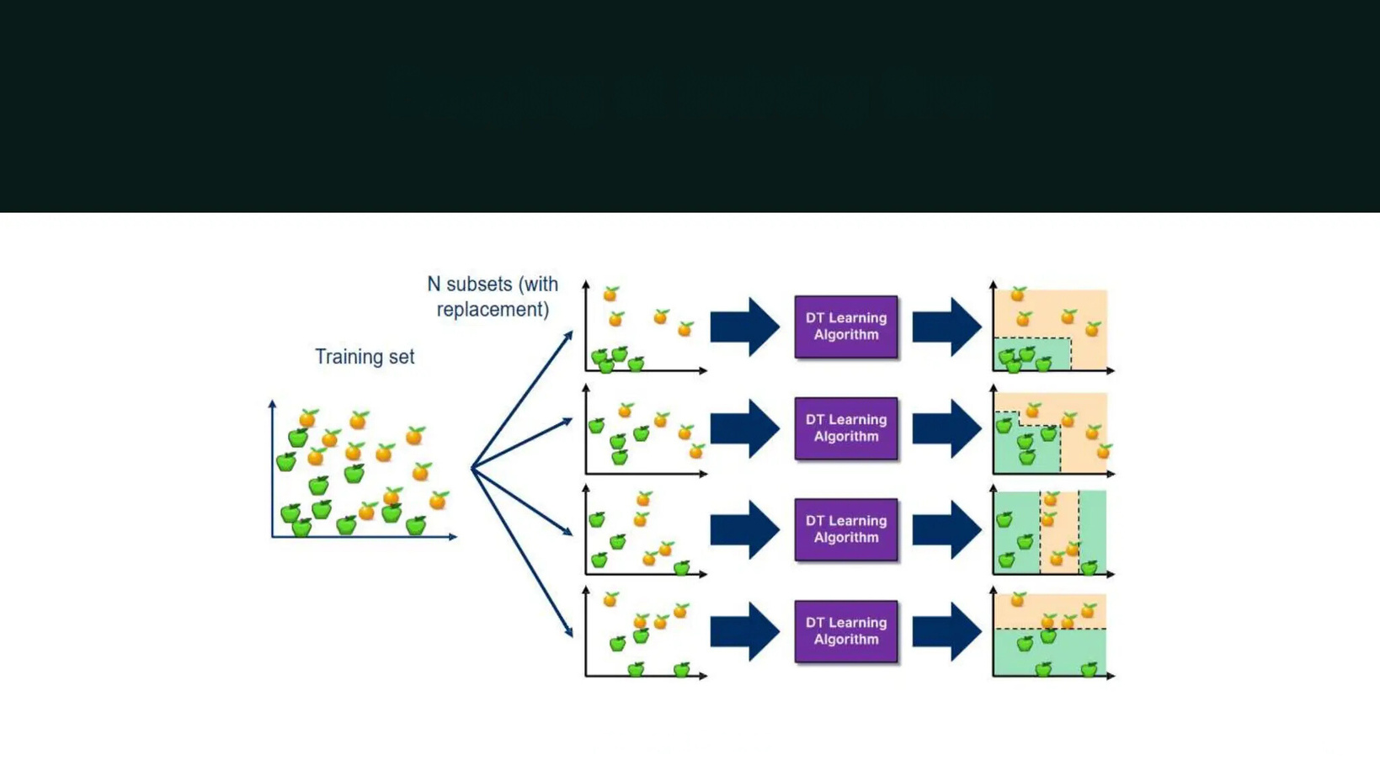
SFFA
Dataset Preparation
Bootstrap Aggregating (Bagging)
Creating a different training subset randomly from the original training dataset with replacement is called Bagging. With replacement refers to the bootstrap sample having duplicate elements. Reduces variance, helps to avoid overfitting.
Bagging at training time

Slide 17
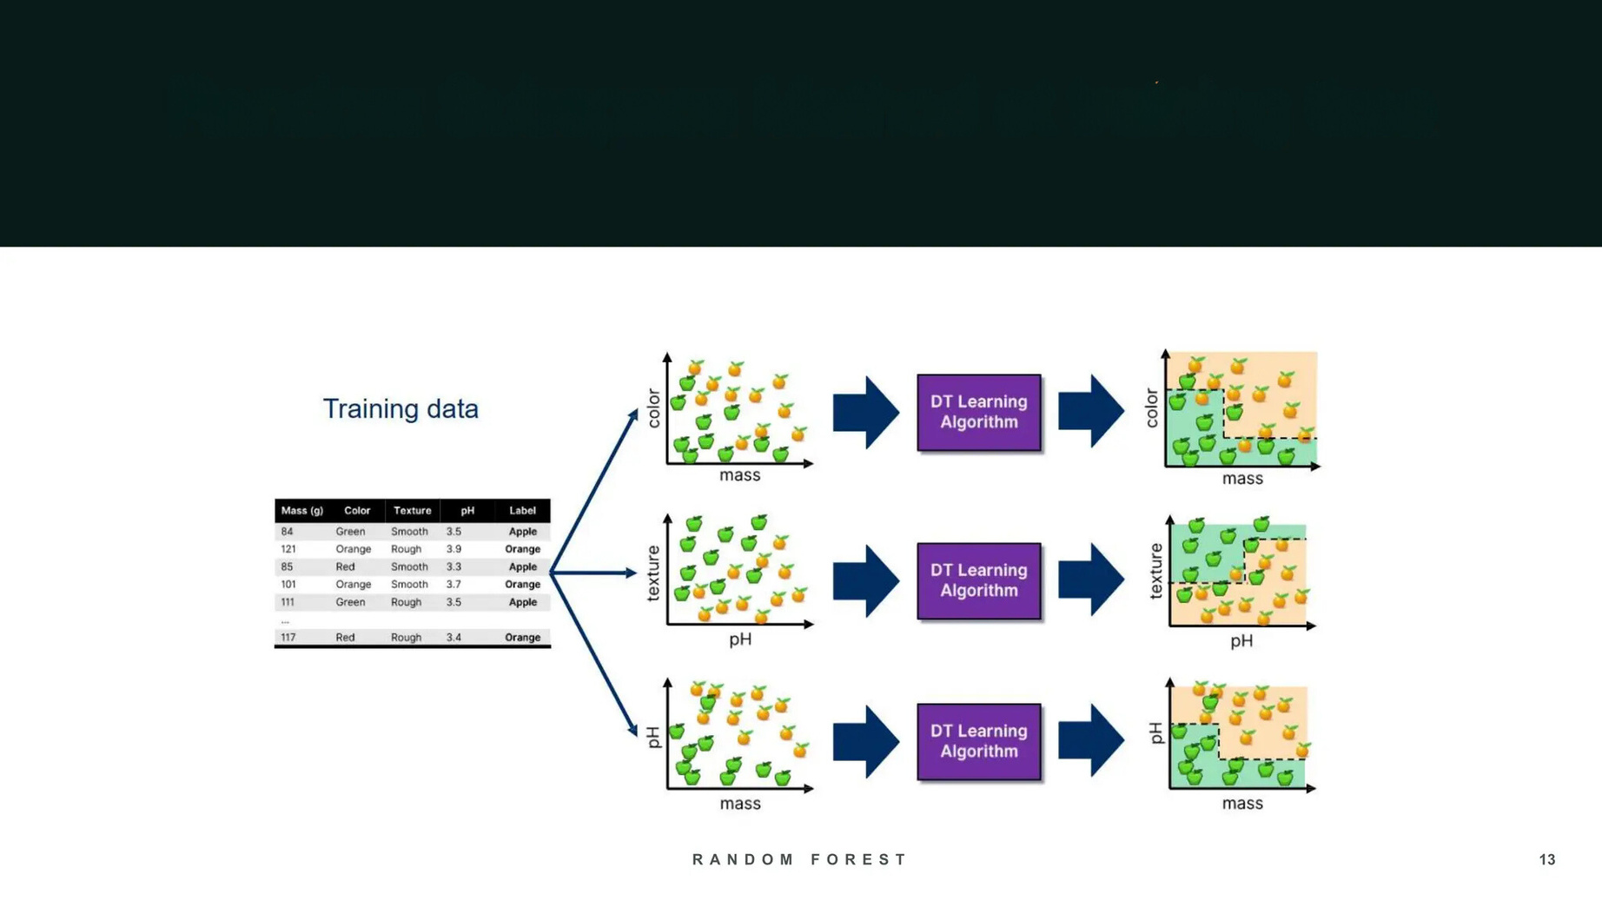
SFFA
Dataset Preparation
Random Subspace Method(Feature Bagging)
While building the tree, for splitting, a randomly selected subset of the features are used. So, the trees are more different having low correlation.
Random Subspace Method at training time

Slide 18
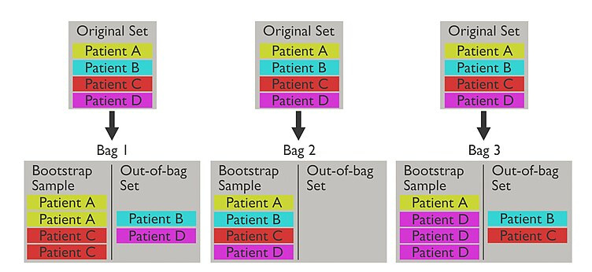
Dataset Preparation
SFFA
Out-Of-Bag (OOB)
The out-of-bag dataset represents the remaining elements which were not in the bootstrap dataset (Unseen). Used for cross validation or to evaluate the performance.

Slide 19
SFFA
Advantages and Disadvantages of Random Forests
Advantages
Disadvantages
Versatile uses.
Easy-to-understand hyperparameters.
Classifier doesn't overfit with enough trees.
Increased accuracy requires more trees.
More trees slow down model.
Can't describe relationships within data.

Slide 20
SFFA
Applications of Random Forest
Health Care: Health professionals use random forest systems to diagnose patients.
Stock Market: Financial analysts use it to identify potential markets for stocks.
E-Commerce: Through this system, e-commerce vendors can predict the preferences of customers based on past consumption behavior.

Slide 21
SFFA
Why Random Forests is a Good Fit for Financial Application
Handles Complex Relationships: Financial data often has non-linear relationships (e.g., income level, spending habits, and risk tolerance).
Robustness to Noise and Outliers: Financial data is typically noisy and may contain outliers, such as extremely high or low incomes or unusual spending habits
Works Well with Categorical and Continuous Variables: Financial data often contains both categorical (e.g., marital status, financial goals) and continuous variables (e.g., income, expenses).

Slide 22
How we will apply Random Forest
SFFA
Objective
Why Choose Bagging?
Data Collection
Predict the most suitable budgeting rule (50/30/20, 70/20/10, and 60/20/20) for users based on financial profiles.
Reduces variance and prevents overfitting.
Enhances prediction accuracy and stability.
Utilizes Out-of-Bag (OOB) evaluation for internal validation.
Throw open data platform.
By collecting surveys.

Slide 23
SFFA
Thank You
Any question ?

